Slide 1
Prediction Challenge 1
Marc De Chavez
April 4, 2017
Data 101

Slide 2
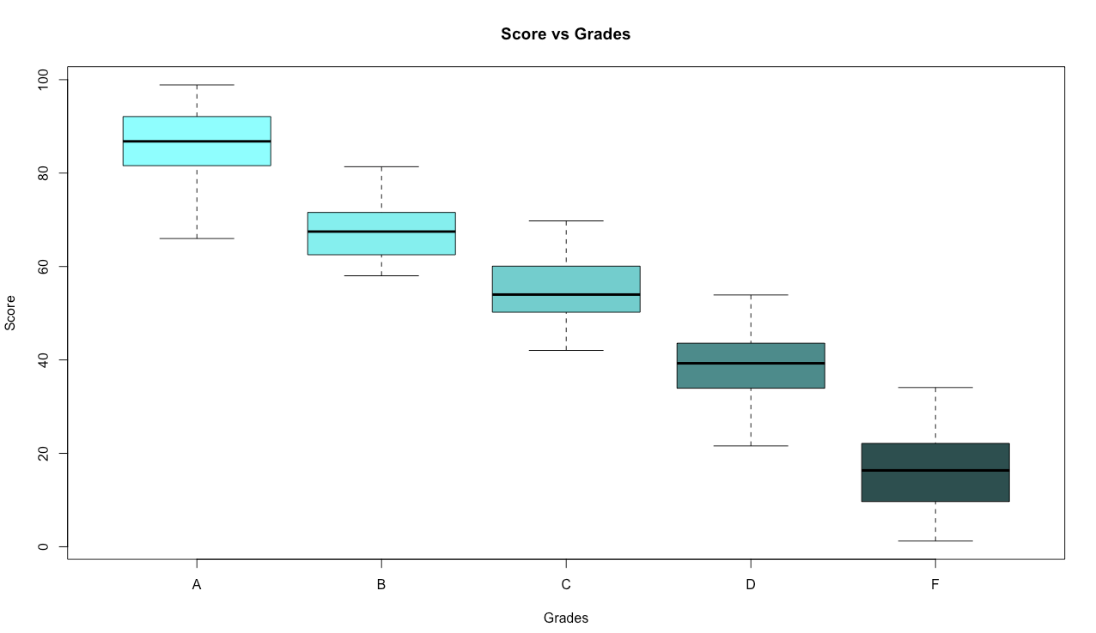
> boxplot(M2017_train$SCORE~M2017_train$GRADE, xlab="Grades", ylab="Score", main = "Score vs Grades", col = c('darkslategray1', 'darkslategray2', 'darkslategray3','darkslategray4','darkslategray'))

Slide 3
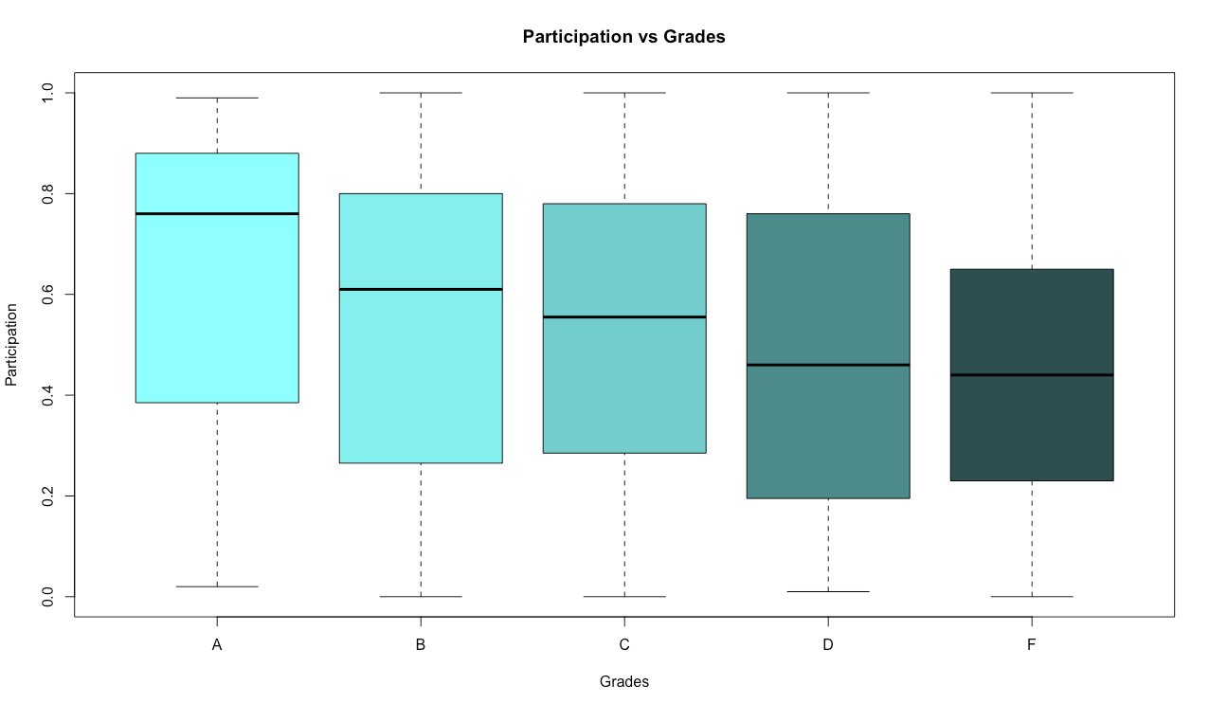
> boxplot(M2017_train$PARTICIPATION~M2017_train$GRADE, xlab="Grades", ylab="Participation", main = "Participation vs Grades", col = c('darkslategray1', 'darkslategray2', 'darkslategray3','darkslategray4','darkslategray'))

Slide 4
> test <- M2017_test_students
> Myprediction <- test
> myprediction <- myprediction[order(myprediction$STUDENTID),]
> decision <- rep('F',nrow(myprediction))
> decision[(myprediction$SCORE*.90 + myprediction$PARTICIPATION*100*.10) > 20]<- 'D'
> decision[(myprediction$SCORE*.90 + myprediction$PARTICIPATION*100*.10) > 40]<- 'C'
> decision[(myprediction$SCORE*.90 + myprediction$PARTICIPATION*100*.10) > 60]<- 'B'
> decision[(myprediction$SCORE*.90 + myprediction$PARTICIPATION*100*.10) > 70 ]<- 'A'
> myprediction$GRADE<-decision
> myprediction$GRADE
> M2017_sample_submission <- M2017_sample_submission[order(M2017_sample_submission$STUDENTID),]
> M2017_sample_submission$GRADE = myprediction$GRADE

